Slide 1
SOAP -ATTACHMENTS
Prof. S M. Shedole

Slide 2
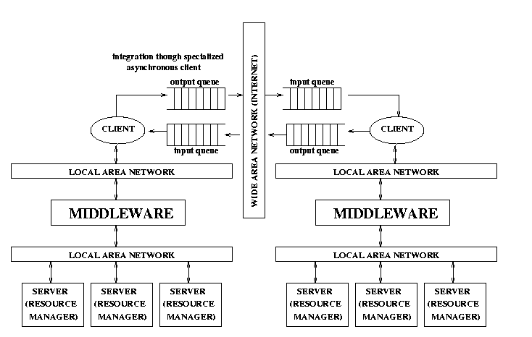
How to implement this with SOAP?

Slide 3
Implementing Message Queues
To implement asynchronous queues with SOAP
  SOLUTION A:
    use SOAP to encode the messages
    create an HTTP based interface for the queues
    use an RPC/SOAP based engine to transfer data back and forth between the queues
  SOLUTION B:
    use SOAP to encode the messages
    create appropriate e-mail addresses for each queue
    use an e-mail (SMTP) binding for transferring messages

Slide 4
Pros & Cons
Not ,, a standard.
Hence, there is no guarantee that different queuing systems with a SOAP will be able to talk to each other: many advantages of SOAP are lost
The fact that SOAP is so simple also makes it difficult to implement these solutions: a lot additional functionality is needed to implement reliable, practical queue systems

Slide 5
The need for attachments
SOAP is based on XML and relies on XML for representing data types
The original idea in SOAP was to make all data exchanged explicit in the form of an XML document much like what happens with IDLs in conventional middleware platforms
This approach reflects the implicit assumption that what is being exchanged is similar to input and output parameters of program invocations
This approach makes it very difficult to use SOAP for exchanging complex data types that cannot be easily translated to XML (and there is no reason to do so): images, binary files, documents, proprietary representation formats, embedded SOAP messages, etc.

Slide 6
<env:Body>
<p:itinerary xmlns:p="http://.../reservation/travel">
<p:departure>
<p:departing>New York</p:departing>
<p:arriving>Los Angeles</p:arriving>
<p:departureDate>2001-12- 4</p:departureDate>
<p:departureTime>late afternoon</p:departureTime>
<p:seatPreference>aisle</p:seatPreference>
</p:departure>
<p:return>
<p:departing>Los Angeles</p:departing>
<p:arriving>New York</p:arriving>
<p:departureDate>2001-12 - 20</p:departureDate>
<p:departureTime>mid-
morning</p:departureTime>
<p:seatPreference/>
</p:return>
</p:itinerary>
</env:Body>

Slide 7
A possible solution
There is a “SOAP messages with attachments note” proposed in 11.12.02 that addresses this problem
It uses MIME types (like e-mails)
It is based in including the SOAP message into a MIME element that contains both the SOAP message and the attachment
The solution is simple and it follows the same approach as that taken in e-mail messages: include a reference and have the actual attachment at the end of the message
The MIME document can be embedded into an HTTP request in the same way as the SOAP message
The Apache SOAP 2.2 toolkit supports this approach

Slide 8
Problems with this approach:
  handling the message implies dragging the attachment along, which can have performance implications for large messages
  scalability can be seriously affected as the attachment is sent in one go (no streaming)
  not all SOAP implementations support attachments
  SOAP engines must be extended to deal with MIME types (not too complex but it adds overhead)
There are alternative proposals like DIME of Microsoft (Direct Internet Message Encapsulation) and WS-attachments

Slide 9
Attachments in SOAP
MIME-Version: 1.0
Content-Type: Multipart/Related; boundary=MIME_boundary; type=text/xml;
start="<claim061400a.xml@claiming-it.com>"
Content-Description: This is the optional message description.
--MIME_boundary
Content-Type: text/xml; charset=UTF-8
Content-Transfer-Encoding: 8bit
Content-ID: <claim061400a.xml@claiming-it.com>
<?xml version='1.0' ?>
<SOAP-ENV:Envelope
xmlns:SOAP-ENV="http://schemas.xmlsoap.org/soap/envelope/">
<SOAP-ENV:Body>
..
<theSignedForm href="cid:claim061400a.tiff@claiming-it.com"/>
..
</SOAP-ENV:Body>
</SOAP-ENV:Envelope>
--MIME_boundary
Content-Type: image/tiff
Content-Transfer-Encoding: binary
Content-ID: <claim061400a.tiff@claiming-it.com>
...binary TIFF image...
--MIME_boundary--
SOAP MESSAGE
From SOAP Messages with Attachments. © W3C Note 11 December 2000
ATTACHMENT

Slide 10
The problems with attachments
Attachments are relatively easy to include in a message and all proposals (MIME or DIME based) are similar in spirit
The differences are in the way data is streamed from the sender to the receiver and how these differences affect efficiency
  MIME is optimized for the sender but the receiver has no idea of how big a message it is receiving as MIME does not include message length for the parts it contains
  this may create problems with buffers and memory allocation
  it also forces the receiver to parse the entire message in search for the MIME boundaries between the different parts
All these problems can be solved with MIME as it provides mechanisms for adding part lengths and it could conceivably be extended to support some basic form of streaming
Technically, these are not very relevant issues and have more to do with marketing and control of the standards
The real impact of attachments lies on the specification of Web services (discussed later on)

Slide 11
SOAP as simple protocol
SOAP does not include anything about:
  reliability
  complex message exchanges
  transactions
  Security
As such, it is not adequate by itself to implement industrial strength applications that incorporate typical middleware features such as transactions or reliable delivery of messages

Slide 12
Ctd..
SOAP does not prevent such features from being implemented but they need to be standardized to be useful in practice:
  WS-security
  WS-Coordination
  WS-Transactions
A wealth of additional standards are being proposed to add the missing functionality

